Slide 1
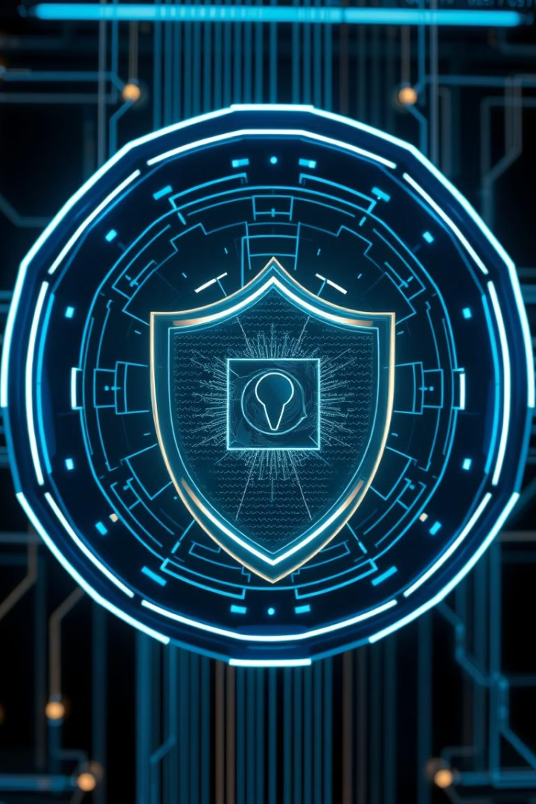

AI vs. AI: Defending Against Malicious AI Agents
This presentation explores the rising threat of malicious AI agents and AI-driven defense models. We'll cover the problem, solutions, real-world examples, and future enhancements. Prepare to dive into the evolving battle of AI vs AI in cybersecurity.

Slide 2
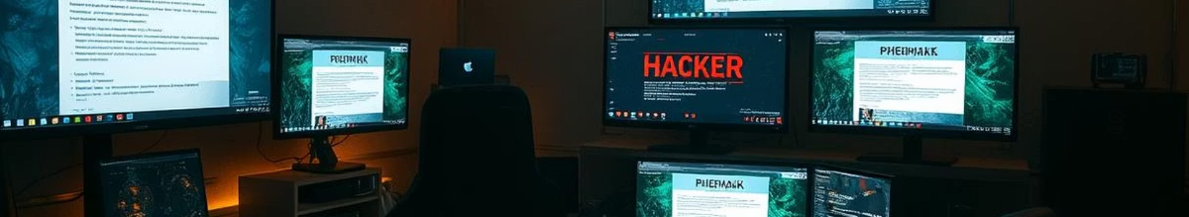

The Problem: Malicious AI Agents
AI-Powered Attacks
Adversarial Attacks
Phishing, malware, and DDoS attacks enhanced with AI techniques.
Tricking AI systems like image recognition and NLP with crafted inputs.
Data Poisoning
Deepfake Threats
Corrupting training data to weaken AI defenses and breach security.
Used in social engineering attacks, causing increasing concern in 2024.

Slide 3


The Solution: AI-Driven Defense Models
Anomaly Detection
Adversarial Training
Identifies unusual patterns to flag potential threats automatically.
Strengthens AI models by training them against crafted attack examples.
Reinforcement Learning
Explainable AI (XAI)
Enables dynamic and adaptive responses to evolving threats in real-time.
Provides transparency, helping analysts understand AI defense decisions.

Slide 4

Code/Tool Breakdown: Building Defense Systems
Python Libraries
Defense Tools
TensorFlow
Adversarial training code snippets
PyTorch
AI-powered IDS with Snort and Zeek
Scikit-learn
MITRE ATT&CK framework integration

Slide 5


Real-World Use Cases: Defensive AI in Action
Fraud Detection
AI significantly reduces global credit card fraud losses.
Network Security
Identifies and blocks malicious traffic in enterprise networks.
Endpoint Protection
AI-based antivirus software improves threat detection accuracy.
Darktrace Antigena
Prevented WannaCry-style ransomware attacks in 2024 effectively.

Slide 6


Future Enhancements: The Next Frontier
1
Automated Adversarial Training
Enables continuous model hardening without manual intervention.
2
Self-Evolving Defenses
Uses meta-learning for adaptive, autonomous threat responses.
3
Quantum Security Integration
Potentially revolutionizes encryption and AI threat detection.
4
Decentralized AI
Blockchain-powered defense systems offer robust tamper resistance.

Slide 7

Challenges and Considerations
Ethical Concerns
Transparency
Bias Mitigation
Continuous Adaptation
Ensuring AI-driven defense respects privacy and rights.
Explainability is critical for trust and user confidence.
Addressing biases to prevent unfair or ineffective defenses.
Monitoring and updating AI defenses to handle new threats.

Slide 8
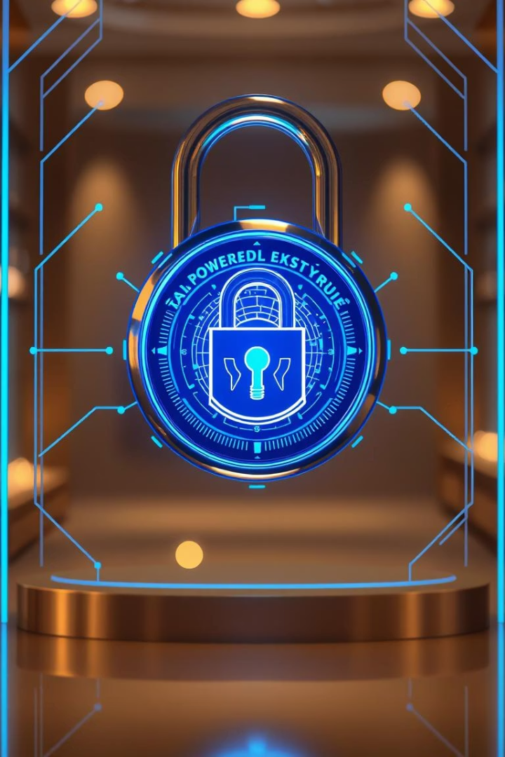

Conclusion: Embracing AI for a Secure Future
New Cyber Reality
AI vs AI is reshaping cybersecurity battles worldwide.
Proactive Defense
Organizations must adopt AI-based proactive security strategies.
Ongoing Research
Collaboration and innovation are keys to staying ahead.
Q&A and Resources
Open for questions, further learning, and discussions.

Slide 9
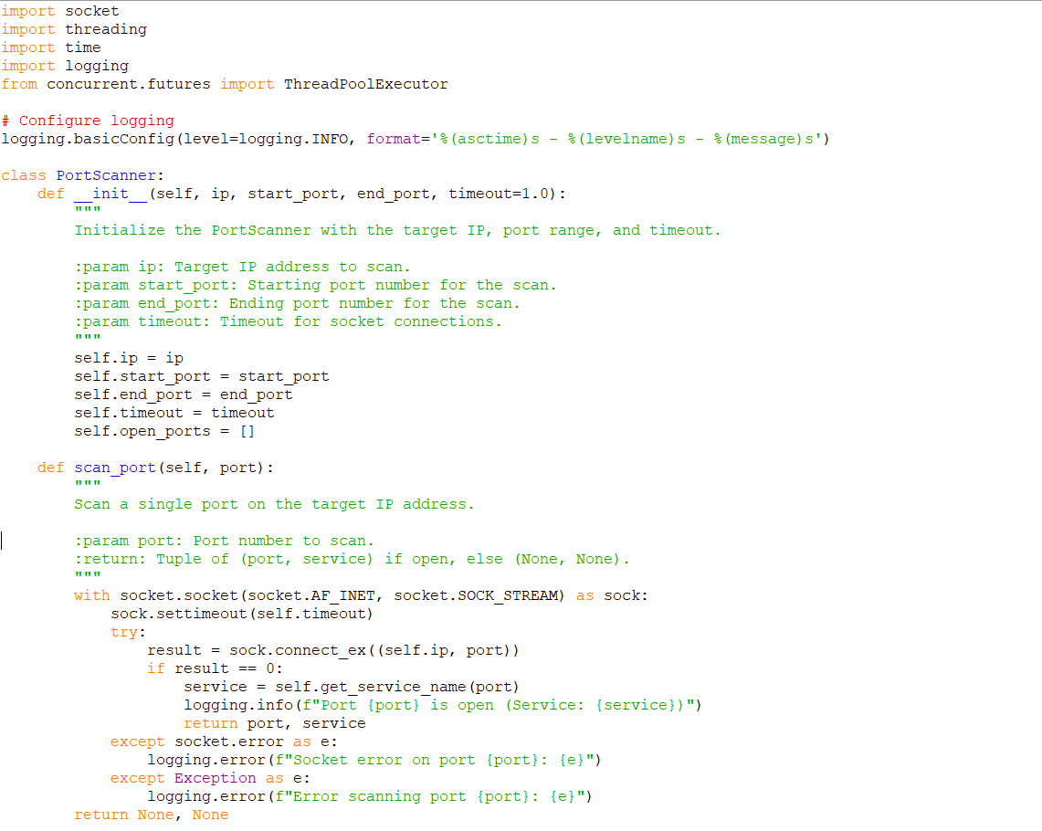


Slide 10
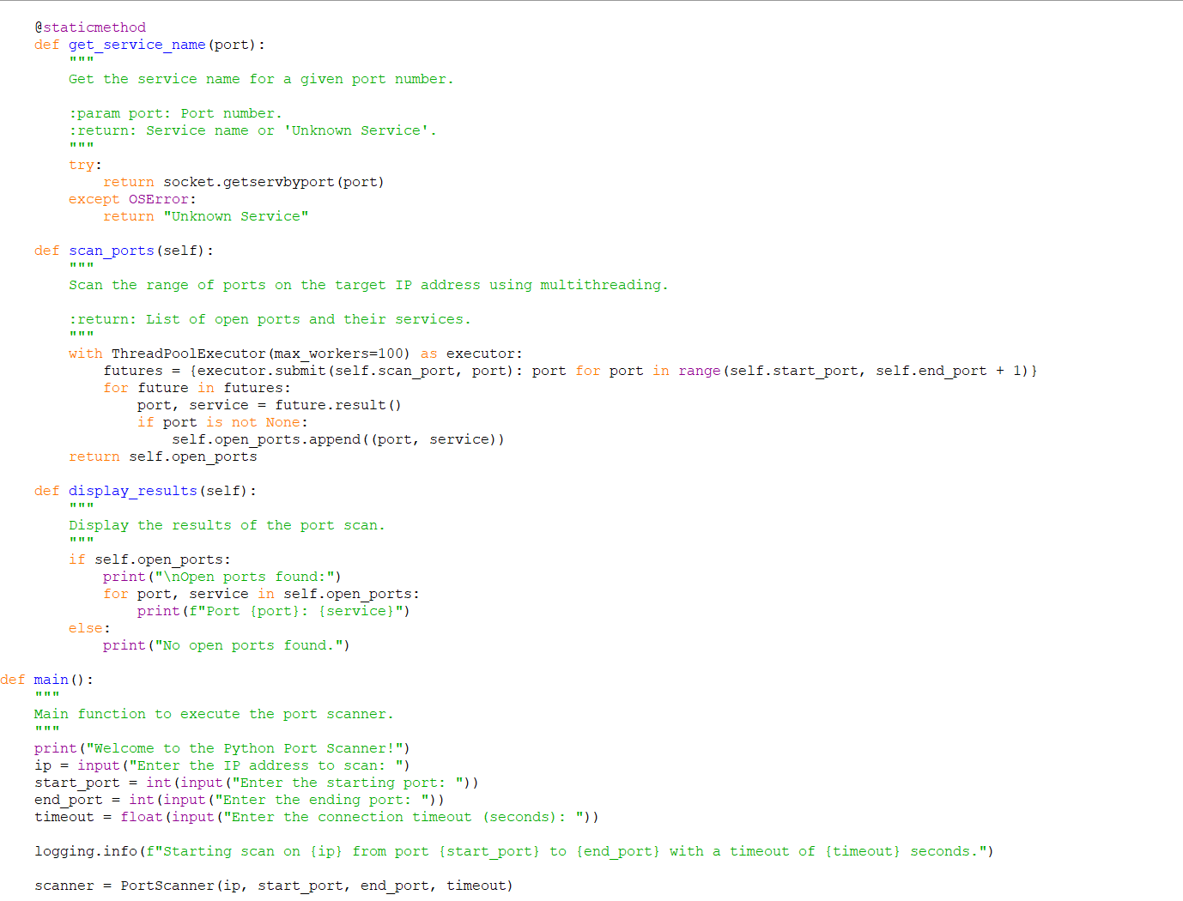


Slide 11
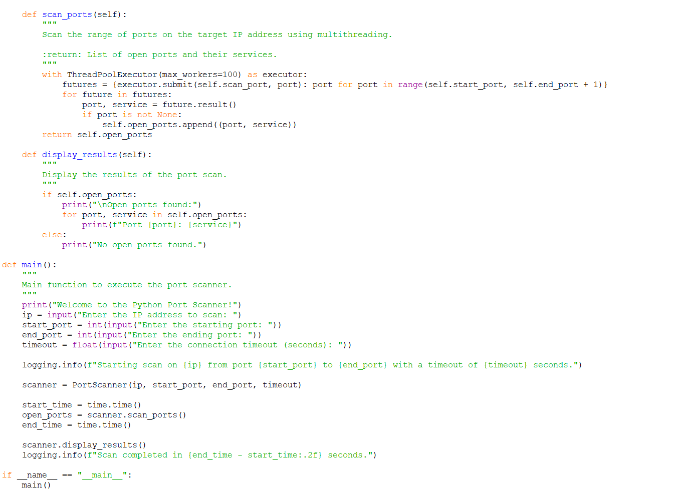


Slide 12
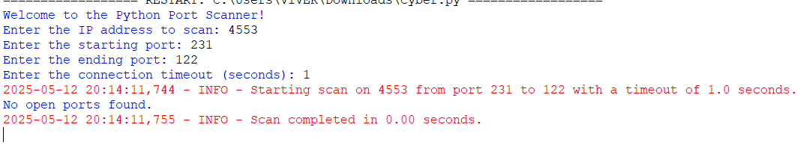


Slide 13
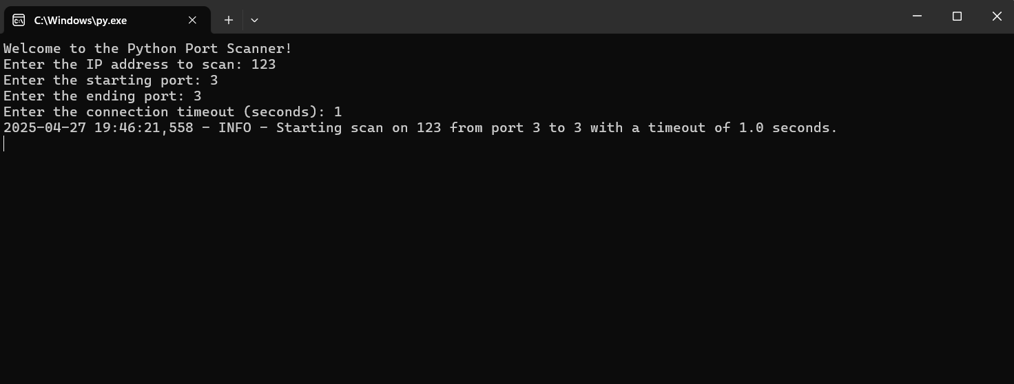


Slide 14

https://youtu.be/sm8fvVYaT6Q?si=e8_JQhztRY19GCbi
https://agileblue.com/ai-threats-vs-ai-defenses-the-battle-for-cyber-supremacy/
https://right-hand.ai/blog/ai-agents-vs-agentic-ai-in-cybersecurity/
https://www.lesswrong.com/posts/LPHMMMZFAWog6ty5x/ctrl-z-controlling-ai-agents-via-resampling

